Slide 1
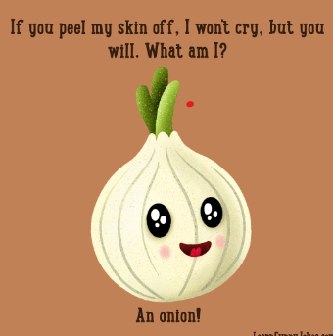
Project 1 Presentation
Ingrediantfy App
Presented by
Andrei Grigoras
Ian Millichamp
Abby Egbo
10/02/2023

Slide 2

About the App
The App enables users to search for dishes based on their ingredients and cuisine options.
Users can plan their meals, save recipes and check calorie contents based on the dish selected.

Slide 3
How to use
User log on to the page
Search for their dishes – e.g. Fish
Lists of 5 dishes that matches request is displayed The output information shows nutritional breakdown, calories per serving, price of dish, nutritional value, recipes preparation time & % of their nutritious daily requirement.
We also implement a Joke Element which users can check out while cooking their favorite recipe!

Slide 4


User Story
We deliberated on a few APIs - Finance, currencies, exercises, however we decided to go for the Healthy eating and jokes APIs.
We believe that laughter and food can be positively correlated in some situations for good health, such as when people are enjoying a meal with friends and family and sharing laughs and good conversation.

Slide 5
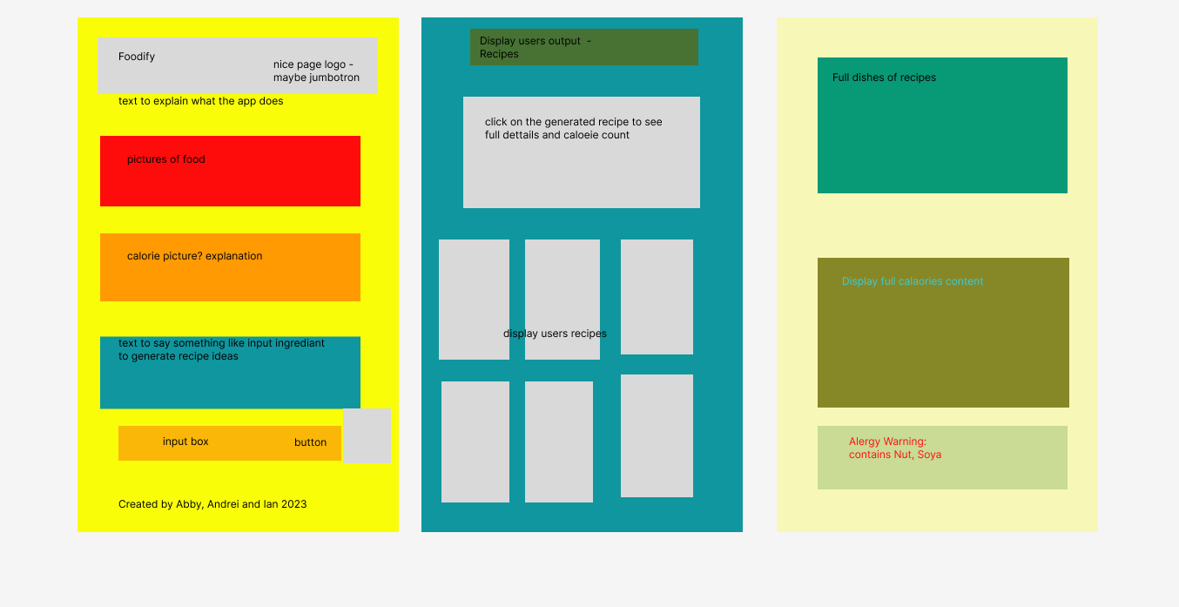
Planning Stage – Wire Framing - figma

Slide 6
Tool and Application
Html
CSS
Figma designing tool
Javascript
Bootstrap 5.3
APIs – Spoonocular Api
Ninja Joke Api

Slide 7


APIs used
https://spoonacular.com/food-api – Healthy food API
https://api.api-ninjas.com/v1/jokes Ninja food Joke Quotes

Slide 8
How to Develop the App further
Add Allergy information
Using more that allow greater searches

